Slide 1
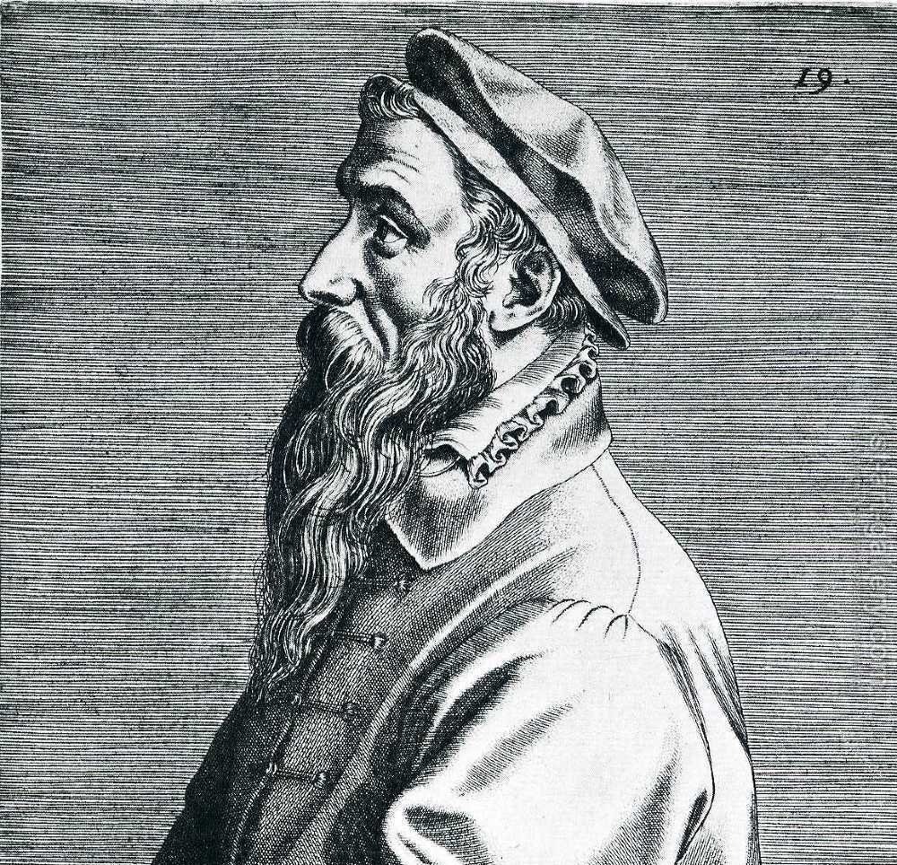



Pieter Bruegel the elder
Khush Wadhwa, Pd. 3
Firdman Global Studies

